Slide 1


CompTIA Linux+ V8 TTT Session 1:
Linux Overview, Setup, Shell Navigation, Getting Help
September 9, 2025
@TeachCompTIA #Linux+TTT

Slide 2
Certificate of Attendance
Slides
Bios
Q&A
Call to Action
Multimedia
Today’s Resources
ON24 Help
Group Chat
Survey

Slide 3
Exam Voucher Qualifications
Participate in all 5 sessions (live or on-demand) during the date range for live series.
Be an active member of CIN
Be involved with a CompTIA training partner or independent instructor teaching CompTIA certifications.

Slide 4

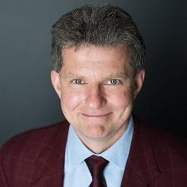
Linux+ Team
Guest:
Jason Eckert
Dean of Technology
triOS College
jason.eckert@trios.com
Host:
Stephen Schneiter
Instructor Network Program Director
CompTIA
sschneiter@comptia.org

Slide 5
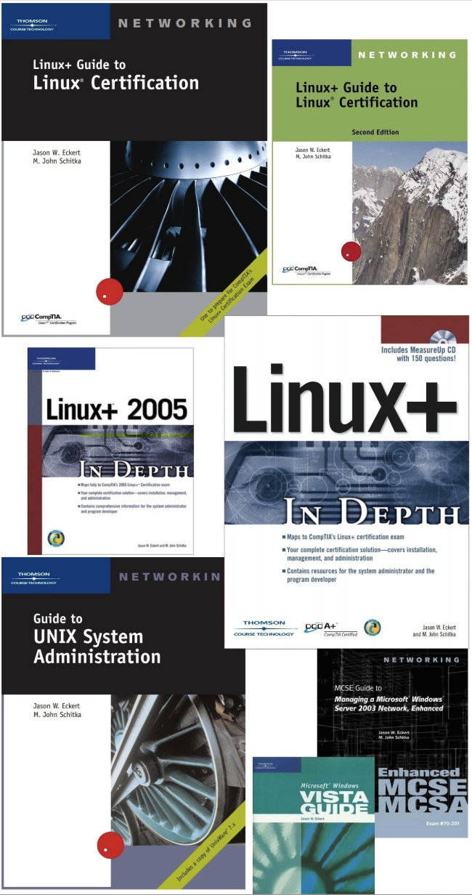

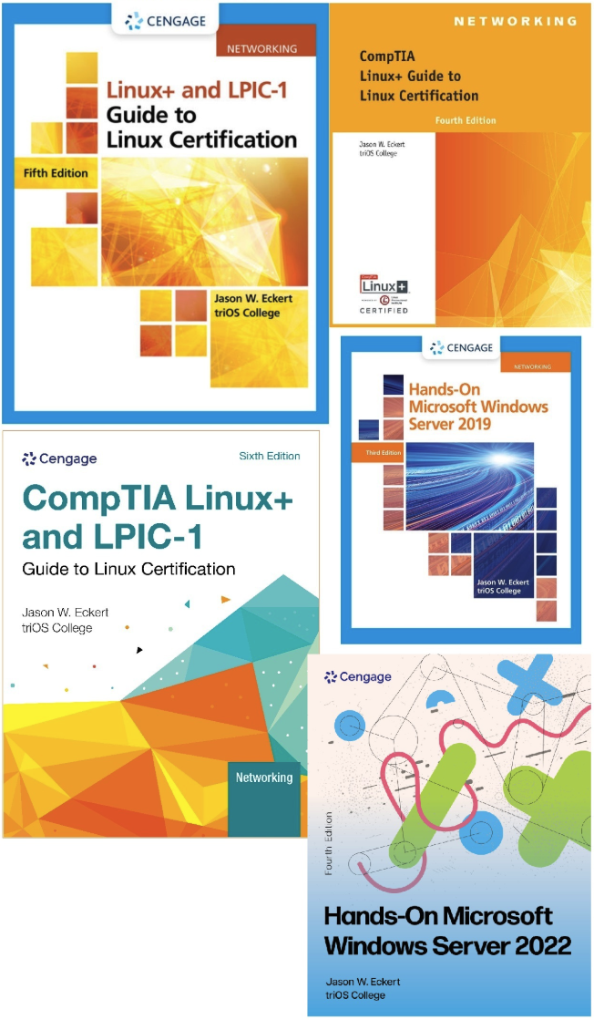

Slide 6
Jason Eckert
Wrote 27 textbooks for Cengage, Wiley, Novell, etc.
17 on Linux Administration
11 geared to Linux+
Worked as a software developer for both Sun Microsystems and Microsoft
Taught IT and software development @ triOS College since 1998
Stayed working in the industry during this entire time!
Currently work weekends as a cloud architect and platform engineer for several incubated startups in the Toronto-Waterloo corridor (Canada’s Silicon Valley)
My website, bio, and blog: https://jasoneckert.github.io

Slide 7



The CompTIA Instructor Network (CIN) is a worldwide community for instructors who provide CompTIA certification training.
Benefits of being a community member include:
Communicate and collaborate with CompTIA staff and other instructors.
Access resources for students to understand the value of getting certified.
Receive complimentary training and tools from CompTIA to enrich your classroom.
Become proficient at teaching CompTIA standards.
Share best practices and resources with each other.
https://cin.comptia.org

Slide 8

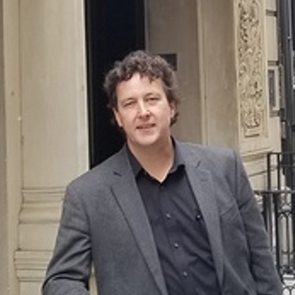
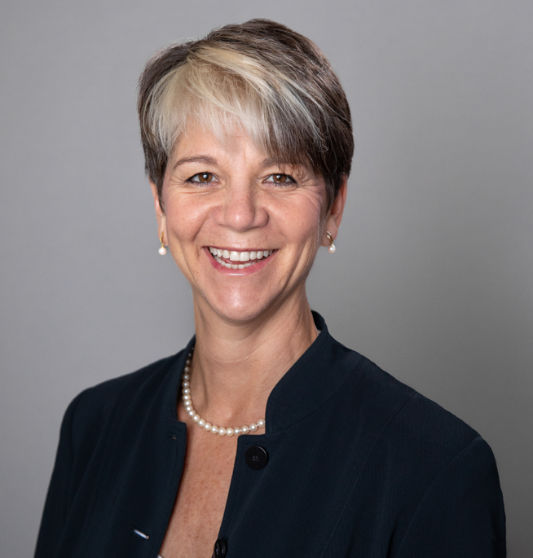

CIN The Pulse: Managing critical space cybersecurity: Guarding against the failure of imagination
What: One-hour webinar investigating concepts such as the different mindsets that OT and IT workers have, as well as implementing secure by design principles
When: Wednesday, October 1, 2025, 11:00 a.m. CDT (1 hour)
Where: ON24
Who: James Stanger, Chief Technology Evangelist, Renee Wynn, former CIO of NASA
Register: https://bit.ly/CIN-ThePulse-Oct25
@TeachCompTIA

Slide 9
Linux+ V8 TTT Session Outline
Date | Topic
09/09/2025 | Linux overview, setup, shell navigation, getting help
09/11/2025 | Filesystem navigation, working with text files, file management
09/16/2025 | File permissions, filesystem administration
09/18/2025 | Shell features (BASH), shell scripting, Python scripting, Git
09/23/2025 | System initialization, localization, compression, backup and software
09/25/2025 | Managing processes, kernel modules, users and logs
09/30/2025 | Network configuration and remote management
10/02/2025 | Configuring network services, cloud and automation (part 1)
10/07/2025 | Cloud and automation (part 2), security
10/09/2025 | Troubleshooting, performance , preparing for Linux+
✓

Slide 10

Your Turn!
Tell us about yourself.

Slide 11
Poll 1
What type of training organization best describes your employer?
Academic Education Provider
Commercial Training Provider
Government
Corporate
Publisher

Slide 12
Poll 2
Do you have the CompTIA Linux+ certification? (choose all that apply).
Yes, I am certified with the CompTIA Linux+ XK0-006 Series certification.
Yes, I am certified with the CompTIA Linux+ XK0-005 Series certification.
Yes, I have an older CompTIA Linux+ certification.
No, but I hold other CompTIA certifications.
No, I have a Linux certification through another provider.
I am not currently certified in Linux.

Slide 13
Poll 3
Do you currently offer a Linux+ course in your program?
Yes, we have been offering one for over 2 years.
Yes, we just started to offer one within the past 1-2 years
No, but we are planning to offer a new course with the release of Linux+ V8 in the next year.
No plans to offer right now

Slide 14
Poll 4
How long have you taught Linux?
Long enough to know that rm -rf / is a teachable moment.
A few semesters… I still Google man pages like everyone else.
I'm still in the “turn it off and on again” phase, but I’m committed.
Does “assigning lab work and praying” count as teaching?
This is my first time. Please be gentle.

Slide 15

Chat Question
What are the key things that you want to take away from these sessions?
Answer in the chat window and let’s share.
This photo is for placement only

Slide 16
Introduction

Slide 17
Session Overview
Regardless of whether you have taught Linux before, or are completely new to Linux, these sessions are designed to:
Provide a detailed structure that guide you through the topics in a typical Linux course
Cover the objectives for the new Linux+ (XK0-006) certification exam

Slide 18
Linux+ V8 Overview
Launch date | July 15th, 2025
Exam Number | XK0-006
Exam Format | Multiple-choice & performance-based 90 minutes 60 questions maximum
Required passing score | 720
Linux+ V7/XK0-005 retirement date | January 13th, 2026

Slide 19
Linux+ V8 Objectives
XK0-006
1.0 System Management | 23%
2.0 Services and User Management | 20%
3.0 Security | 18%
4.0 Automation, Orchestration, and Scripting | 17%
5.0 Troubleshooting | 22%

Slide 20
What’s NEW in Linux+ V8
More security (hardening, auditing and compliance)
More automation & scripting (Python, Git, orchestration, IaC/CM)
AI (interaction, usage)
More cloud depth (containers, virtualization, devops, monitoring, service levels)
More troubleshooting (monitoring, performance-specific)

Slide 21
Teaching Linux+
You will need to use 2 Linux distributions to practice all concepts
Fedora Workstation (GNOME desktop) – 4GB+ RAM
Ubuntu Server (command line only) – 2GB+ RAM
Running these in a virtual machine (VM) on a PC/Mac is assumed
Hyper-V on Win11 (x86/ARM)
Oracle VirtualBox on Win11 (x86/ARM) or macOS (x86 or ARM)
VMWare Workstation/Fusion on Win11 (x86/ARM) or macOS (x86/ARM)
UTM on macOS (ARM)

Slide 22
Teaching Linux+
Higher learning curve + many small concepts/commands
Start slow and pick up the pace after comfort level increases
Demonstrate everything interactively to explore concepts and commands
Show students how to leverage AI (faster, non-judgmental)
Start each day with an interactive review
Students will need to practice Linux labs to master concepts

Slide 23

Linux Overview

Slide 24
What is Linux?
An open-source, UNIX-like OS created by Linus Torvalds in 1991
If you release software under an open-source license, others can access and modify the original source code (fix bugs/security, evolve features)
Permissive (e.g., MIT/BSD)
Copyleft (e.g., GPL)
Linux shares most of its structure, software and commands with UNIX OSes: macOS/iOS, FreeBSD, OpenBSD, NetBSD, etc.

Slide 25
What is Linux?
The most powerful and flexible OS today!
Linus Torvalds’ team develops the core Linux kernel
Others develop the software and libraries “distributed” with it
This results in different Linux distributions (distros), such as Red Hat, Fedora, Ubuntu, and SUSE

Slide 26
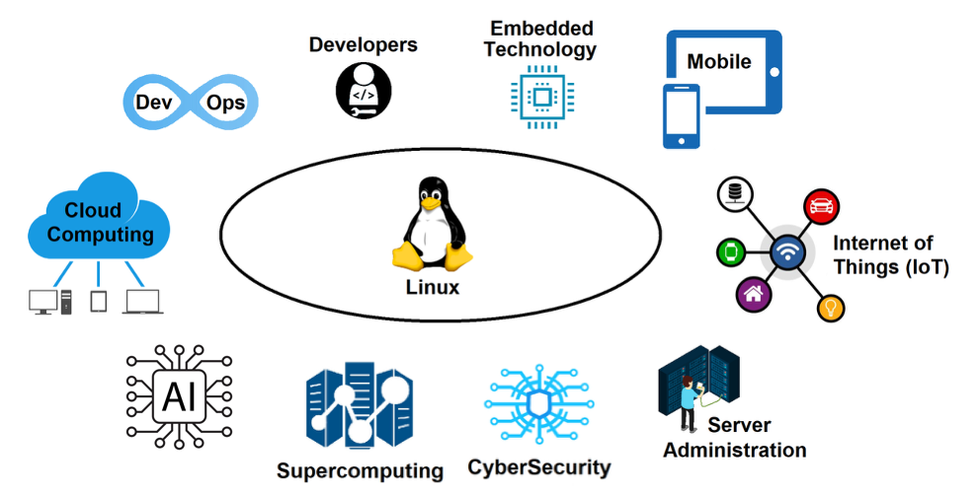
Where is Linux Today?

Slide 27
Where is Linux Today?
Gartner estimated in 2018 that >90% of the world population uses Linux: 84% of embedded devices 100% of supercomputers 82% of smartphones (Android) 68% of tablets (Android) 74% of servers (96% cloud, 24% on-premises) 96% of network appliances (routers, WAPs, NGFWs, etc.) 16% of desktops (including Chromebooks) =69% of all devices worldwide!

Slide 28
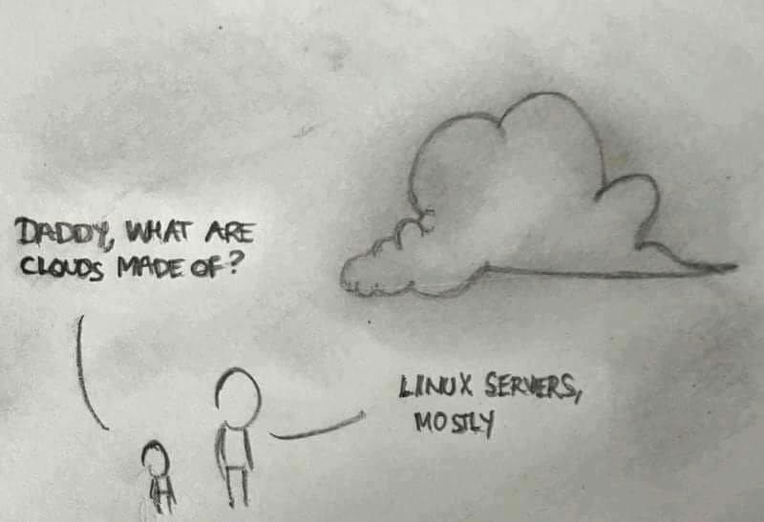
Linux and The Cloud

Slide 29
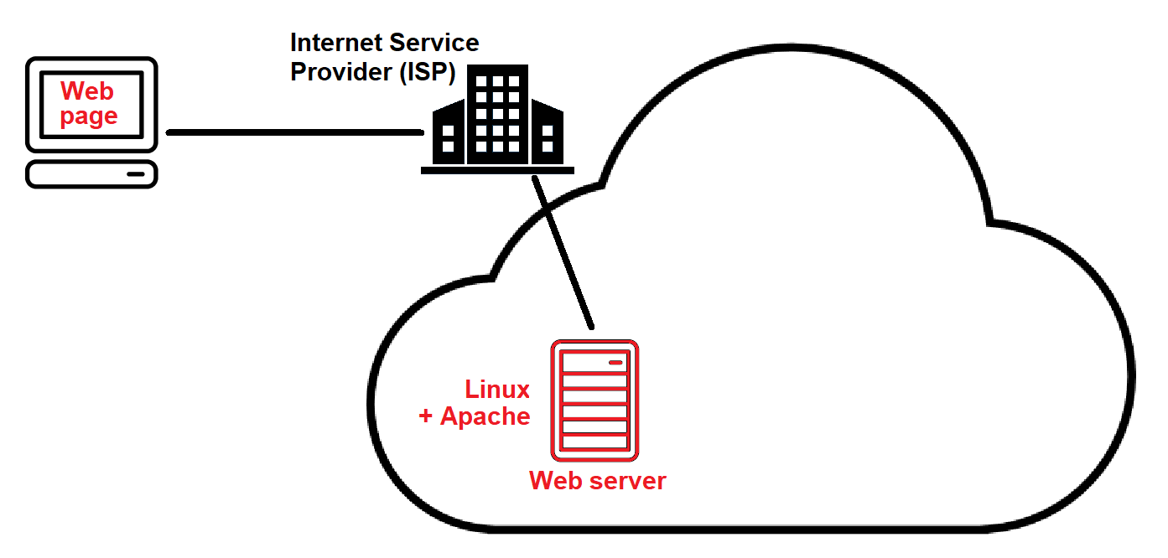
Linux and The Cloud

Slide 30
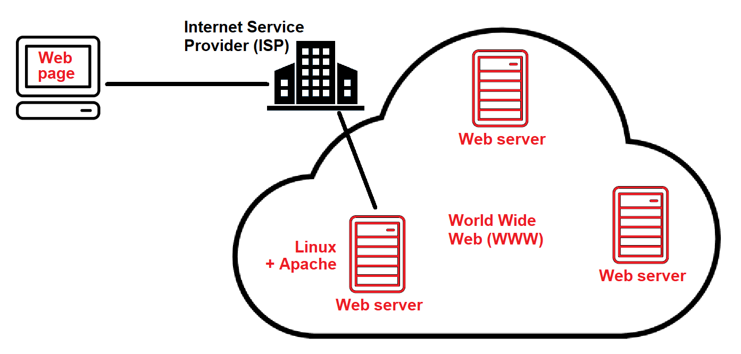
Linux and The Cloud

Slide 31
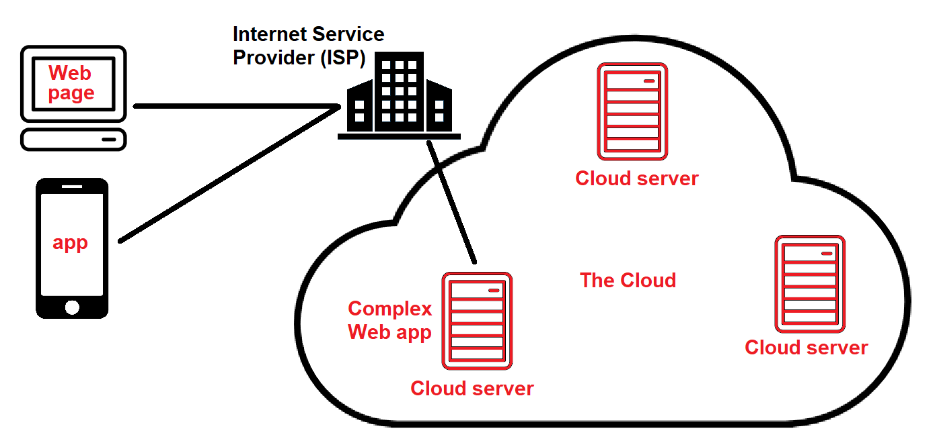
Linux and The Cloud

Slide 32
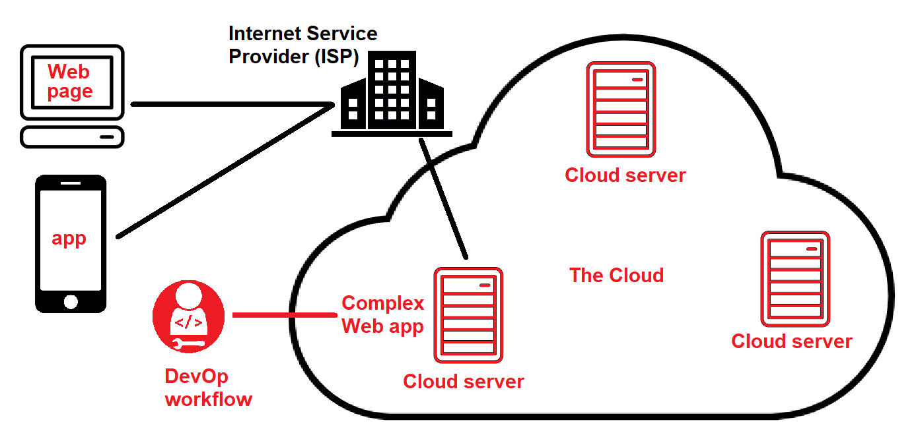
Linux and The Cloud

Slide 33
Course Setup

Slide 34
Course Setup
Install Fedora Workstation (GNOME desktop) first
Ubuntu Server can come later
Avoid discussing filesystem/partitioning concepts (later topic)
Provide clear instructions for setup
Walk students through the initial setup (let’s do this now!)

Slide 35
Shell Navigation and Getting Help

Slide 36
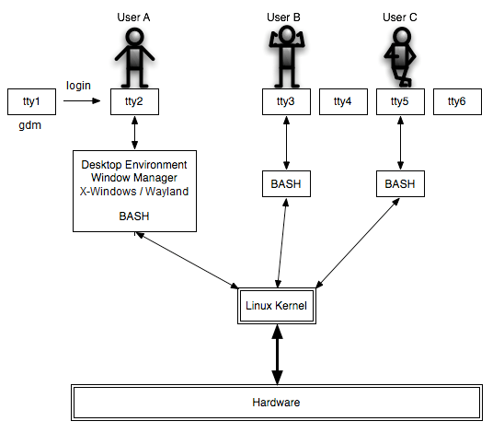
Logging into Linux
Local terminal (tty1-6) Pseudoterminal (pty) X-Windows(X.org)/Wayland Desktop Environments: GNOME (macOS) KDE (Windows)
Shells: BASH, ZSH, FISH, ASH, etc.

Slide 37
Logging into Linux
BASH prompt: user = $ root = #
who w exit (or Ctrl-d) su - root su -c "some command" root

Slide 38
Multiple Terminal windows
Terminal app windows/tabs (Desktop Environment) tmux (BASH) Ctrl-b → % (split horizontal), " (split vertical)

Slide 39
Entering Shell Commands
command options arguments date Date (case sensitive) date -u date --universal (POSIX) *options may not be dashed, or use other symbols date +%s

Slide 40
Entering Shell Commands
finger username (dnf install finger -y first) whoami id echo arguments passwd clear uname -a

Slide 41
Entering Shell Commands
Shift+PgUp and Shift+PgDn Shell metacharacters: command | more date;id;who echo We use the $SHELL shell echo Today is `date`

Slide 42
Entering Shell Commands
Protecting shell metacharacters: echo "You owe me $4.50" (protects most, not $) echo 'You owe me $4.50' (protects all) echo You owe me \$4.50 (protect next character only) Forgot a quote? Ctrl-c (cancels current command) Reset terminal? clear, reset

Slide 43
Entering Shell Commands
Shutting down Linux: wall “The system will be rebooted in 5 min – log off soon!” shutdown –h +5 minutes shutdown -c shutdown –h now or halt shutdown –P now or poweroff shutdown –r now or reboot

Slide 44
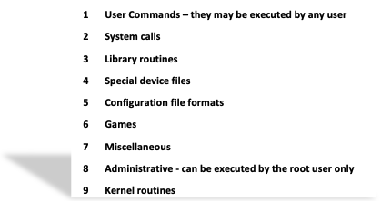
Getting Help
man who man –k cpu or apropos cpu man crontab (dnf install cronie -y first) man 5 crontab whatis crontab info who (dnf install info -y first) help echo help help Or use Google/AI (faster than man pages – model for students!)

Slide 45
Homework Labs

Slide 46
Homework Labs
Refer to the optional exercises for this introductory session, available at https://github.com/jasoneckert/LinuxTTT: 1 - Fedora Workstation Setup 2 - Session 1 Exercises - Introduction to Linux

Slide 47

Discussion time: Please type your questions in chat
Questions over content.
Share you experience.
What would you like to see different moving forward?
Let’s keep the conversation going in the CompTIA Instructor Forum: https://cin.comptia.org

